Slide 1

Chapter 7
Space and Time Tradeoffs
Copyright © 2007 Pearson Addison-Wesley. All rights reserved.

Slide 2
Space-for-time tradeoffs
Two varieties of space-for-time algorithms:
input enhancement — preprocess the input (or its part) to store some info to be used later in solving the problem
  counting sorts
  string searching algorithms
prestructuring — preprocess the input to make accessing its elements easier
  hashing
  indexing schemes (e.g., B-trees)

Slide 3
Sorting by Counting
Count the number of elements smaller than this element.
These numbers indicate the positions.
If there is 0 element smaller than x, x is the 0th element. If there are 3 elements smaller than y, then y is the 3rd element (starting from 0.)

Slide 4
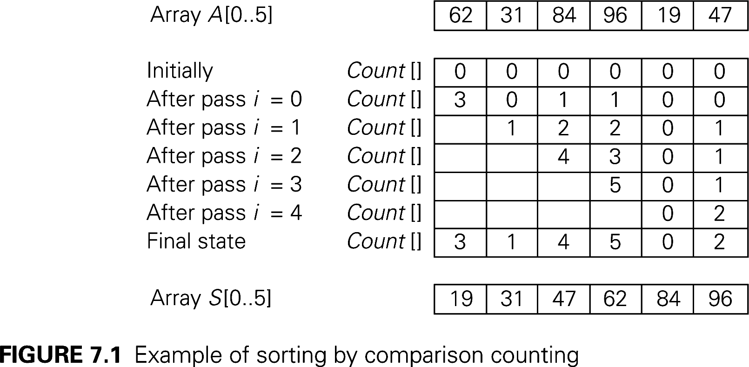
Sorting by Counting

Slide 5
Sorting by Counting
ComparisonCountingSort( A[0..n-1] )
for i ← 0 to n-1 do count[i] ← 0
for i ← 0 to n-2 do
for j ← i + 1 to n -1 do
if A[i] < A[j]
count[j] ← count[j] + 1
else count[i] ← count[i] + 1
for i ← 0 to n-1 do S[ count[i] ] ← A[i]
return S

Slide 6
Sorting by Counting
Time efficiency of this algorithm:
C(n) =
Since the efficiency is the same as selection sort with addition of linear about of spaces, it is hardly recommended for practical use.
n-2
n-1
n-2
Σ
Σ
1 =
Σ
[ (n-1) - (i+1)+1 ]
i=0
j=i+1
i=0
n-2
=
Σ
[ (n - 1 – i ]
i=0
= [ n (n-1) ] / 2 ∈ Θ(n²)

Slide 7
Distribution Count
Sorting by Counting works productively with situation in which elements to be sorted belong to a known small set of values.
Compute frequency, F, the first F[0] positions are filled with e₁, the next F[1] positions are filled with e₂ and so on.
  Positions 0 to F[0] – 1 filled with e₁
  Positions F[0] to F[0]+F[1] – 1 filled with e₂
  Positions F[0]+F[1] to F[0]+F[1] + F[2] – 1 for e₃

Slide 8
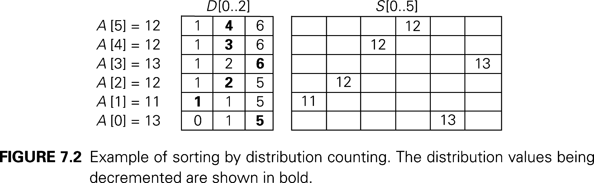
Distribution Count
13 | 11 | 12 | 13 | 12 | 12
Array Values | 11 | 12 | 13
Frequencies | 1 | 3 | 2
Distribution Values | 1 | 4 | 6

Slide 9
15 | 12 | 14 | 13 | 12 | 12

Slide 15
Distribution Count
DistributionCounting(A[0…n-1], L , U)
for j ← 0 to U – L do D[j] ← 0
// Compute frequencies
for i ← 0 to n-1 do D[A[i] – L]) ← D[A[i] – L] + 1
// Use frequencies to compute distribution
for j ← 1 to U – L do D[j] ← D[j-1] + D[j]
for i ← n-1 downto 0 do
j ← A[i] – L
S[D[j] – 1] ← A[i]
D[j] ← D[j] – 1
return S

Slide 16
1513 | 12 | 12 | 1513 | 119749 | 12

Slide 17
Review: String searching by brute force
pattern: a string of m characters to search for
text: a (long) string of n characters to search in
Brute force algorithm
Step 1 Align pattern at beginning of text
Step 2 Moving from left to right, compare each character of
pattern to the corresponding character in text until either all characters are found to match (successful search) or a mismatch is detected
Step 3 While a mismatch is detected and the text is not yet exhausted, realign pattern one position to the right and repeat Step 2

Slide 20
String searching by preprocessing
Several string searching algorithms are based on the input
enhancement idea of preprocessing the pattern
Knuth-Morris-Pratt (KMP) algorithm preprocesses pattern left to right to get useful information for later searching
Boyer -Moore algorithm preprocesses pattern right to left and store information into two tables
Horspool’s algorithm simplifies the Boyer-Moore algorithm by using just one table

Slide 24
Horspool’s Algorithm
A simplified version of Boyer-Moore algorithm:
  preprocesses pattern to generate a shift table that determines how much to shift the pattern when a mismatch occurs
  always makes a shift based on the text’s character c aligned with the last character in the pattern according to the shift table’s entry for c

Slide 25
How far to shift?
Look at first (rightmost) character in text that was compared:
The character is not in the pattern: Shift all
.....C...................... (C not in pattern)
BAOBAB
The character is in the pattern (but not the rightmost): Shift to the rightmost
.....O...................... (O occurs once in pattern)
BAOBAB
.....A...................... (A occurs twice in pattern)
BAOBAB

Slide 26
How far to shift?
The rightmost character matches but no other matching in the pattern: Shift All
....EAB......................
TAGTAB
The rightmost character matches and rightmost char occurs more than once: Shift to the rightmost
.....B......................
BAOBAB

Slide 27
Shift table
Shift sizes can be pre-computed by the formula
distance from c’s rightmost occurrence in pattern among its first m-1 characters to its right end
t(c) = pattern’s length m, otherwise
by scanning pattern before search begins and stored in a table called shift table
Shift table is indexed by text and pattern alphabet
Eg, for BAOBAB:
A B C D E F G H I J K L M N O P Q R S T U V W X Y Z
1 2 6 6 6 6 6 6 6 6 6 6 6 6 3 6 6 6 6 6 6 6 6 6 6 6

Slide 35
Example of Horspool’s alg. application
A B C D E F G H I J K L M N O P Q R S T U V W X Y Z
_
BARD LOVED BANANAS
BAOBAB
BAOBAB
BAOBAB
BAOBAB (unsuccessful search)
1 2 6 6 6 6 6 6 6 6 6 6 6 6 3 6 6 6 6 6 6 6 6 6 6 6
6

Slide 36
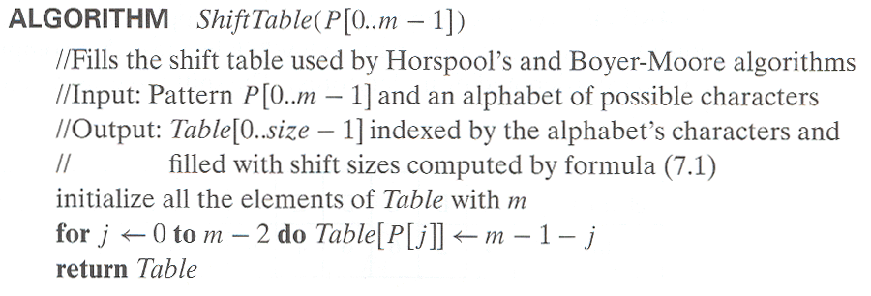
Horspool’s Algorithm

Slide 37
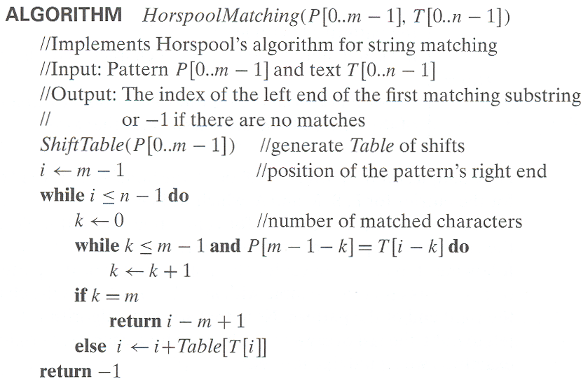
Horspool’s Algorithm

Slide 38
Horspool’s Algorithm
Efficiency of Horspool’s algorithm
- Worst-case efficiency is Θ(nm)
Efficiency is Θ(n) for random texts.
Faster than Brute Force due to skip text.
More space than Brute Force which is varied by the size of shift table.

Slide 43
Hashing
Finding elements in a record is, mostly, done by searching its key.
Key comparison determines whether an element has found. If it is not found, the search continues.
Hashing uses a different approach.
  The value of the key indicates the position in the structure (or table).
  h(K) is a hash function returning the position.

Slide 44
Hash function
K
index
key K
h(K)

Slide 45
Hashing
To find a function (h) that can transform a particular key (K) (a string, number or record) into an index in the table used for storing items of the same type as K, the function h is called a hash function
If h transforms different keys into different numbers, it is called a perfect hash function
To create a perfect hash function, the table has to contain at least the same number of positions as the number of elements being hashed

Slide 46
Hash Functions
  Division
  Folding
  Mid-Square
  Extraction
  Radix Transformation

Slide 47
Hash Functions
The division method is the preferred choice for the hash function if very little is known about the keys
TSize =sizeof(table), as in h(K) = K mod TSize
Example key = 243 Table size = 10
h(243) = 243 mod 10 = 3.
 |  |  | 243

Slide 48
Hash Functions
In the folding method, the key is divided into several parts which are combined or folded together and are often transformed in a certain way to create the target address
Example key = 281-739-405 table size = 100
  Shift Folding
    h(k) = 281 + 739 + 405 = 1425 mod 100 = 25
  Boundary Folding
    h(k) = 281 + 937 + 405 = 1623 mod 100 = 23

Slide 49
Hash Functions (continued)
In the mid-square method, the key is squared and the middle or mid part of the result is used as the address
Example key = 4218 table size = 100
h(k) = mid( 4218² ) = mid (17791524) = 91
0 … 91 … 99
 |  |  | … |  |  | 4218 |  | …

Slide 50
Hash Functions (continued)
In the extraction method, only a part of the key is used to compute the address
Example key = 281-739-405 table size = 10000
h1(k) = 2817
h2(k) = 9405
h3(k) = 2805

Slide 62
Hash Functions (continued)
Using the radix transformation, the key K is transformed into another number base; K is expressed in a numerical system using a different radix

Slide 63
Hash functions
K = 123456789
division
123456789 % TSize
shift folding
(123 + 456 + 789) % TSize
boundary folding
(123 + 654 + 789) % TSize
extraction
5478 % TSize
Notes:
Section 10.1.

Slide 64
Collision Resolution
In the open addressing method, when a key collides with another key, the collision is resolved by finding an available table entry other than the position (address) to which the colliding key is originally hashed
The simplest method is linear probing, for which p(i) = i, and for the ith probe, the position to be tried is (h(K) + i) mod TSize

Slide 65
Collision resolution: linear probing
h(K) = K % 10
33
16
27
23
26
79
88
0
1
2
3
4
5
6
7
8
9
Notes:
Cf. Figure 10.1.

Slide 66
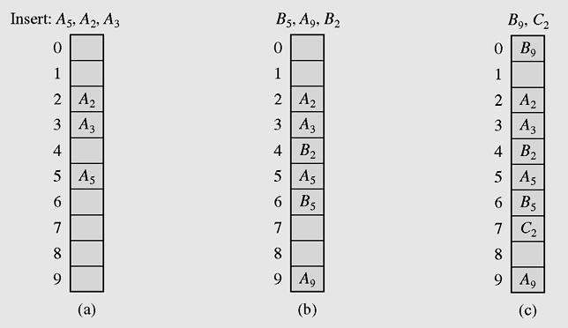
Collision Resolution (continued)
Figure 10-1 Resolving collisions with the linear probing method.
Subscripts indicate the home positions of the keys
being hashed.

Slide 67
Collision Resolution
To avoid clustering, one choice is quadratic probing,
  p(i) = (-1)^{i+1}(i²),
  h(K) + i², h(K) – i²
  h(K), h(K)+1, h(K)-1, h(K)+4, h(K)-4, …,
    h(K) + (Tsize-1)², h(K) - (Tsize-1)²,

Slide 68
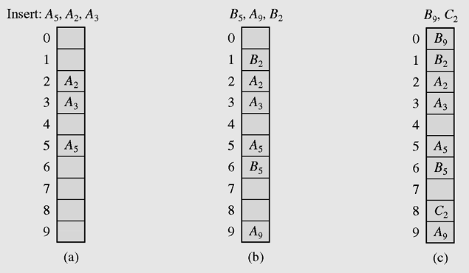
Collision Resolution (continued)
Figure 10-2 Using quadratic probing for collision resolution

Slide 69
Collision Resolution (continued)
Quadratic probing may lead to secondary clusters because keys may hash to the same location when the same probe sequence is used.
A possibility is a random number generator. But the generator must initialize the same seed.
Double hashing is another approach by using another hash function for the collision
  h(K), h(K) + h₂(K), …, h(K) + i.h₂(K)

Slide 70
Collision resolution: linear probing and clustering
0
1
2
3
4
5
6
7
8
9
0.1
0.1
0.1
0.1
0.1
0.1
0.1
0.1
0.1
0.1
0
1
2
3
4
5
6
7
8
9
33
0.1
0.1
0.1
0
0.2
0.1
0.1
0.1
0.1
0.1
Notes:
Assume that data are coming in random order. what is the probability that a particular cell will be occupied?

Slide 71
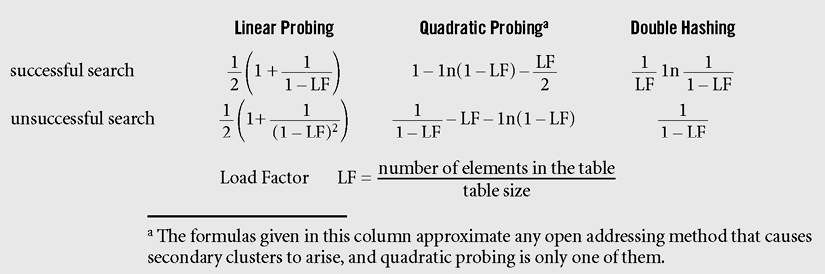
Collision Resolution (continued)
Figure 10-3 Formulas approximating, for different hashing methods,
the average numbers of trials for successful and
unsuccessful searches (Knuth, 1998)

Slide 72
Chaining
In chaining, each position of the table is associated with a linked list or chain of structures whose info fields store keys or references to keys
This method is called separate chaining, and a table of references (pointers) is called a scatter table

Slide 73
Collision Resolution: Chaining
h(K) = K % 10
33
16
27
23
26
79
88
0
1
2
3
4
5
6
7
8
9
Notes:
Cf. Figure 10.5.

Slide 74
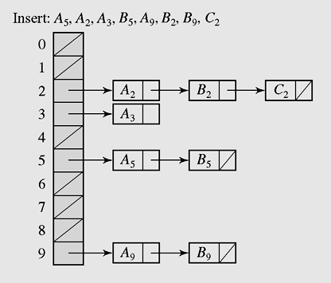
Chaining (continued)
Figure 10-5 In chaining, colliding keys are put on
the same linked list

Slide 75
Chaining (continued)
A version of chaining called coalesced hashing (or coalesced chaining) combines linear probing with chaining
An overflow area known as a cellar can be allocated to store keys for which there is no room in the table

Slide 76
Collision resolution: coalesced hashing
h(K) = K % 10
33
16
27
23
26
79
88
0
1
2
3
4
5
6
7
8
9
-1
-1
-1
4
-1
-1
-1
8
-1
-1
-1
0
-1
Notes:
Cf. Figure 10.6.

Slide 77
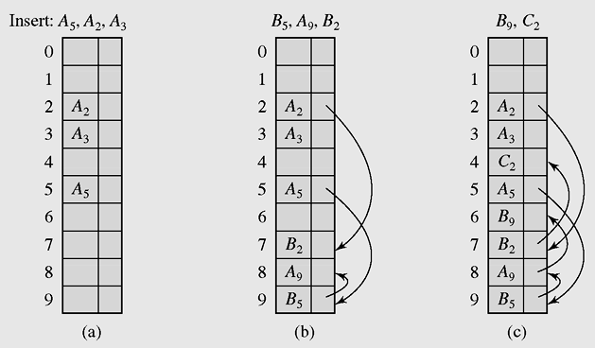
Chaining (continued)
Figure 10-6 Coalesced hashing puts a colliding key in the last
available position of the table

Slide 78
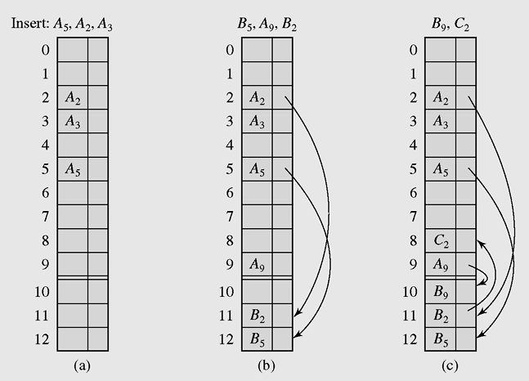
Chaining (continued)
Figure 10-7 Coalesced hashing that uses a cellar

Slide 79
Bucket Addressing
To store colliding elements in the same position in the table can be achieved by associating a bucket with each address
A bucket is a block of space large enough to store multiple items

Slide 80
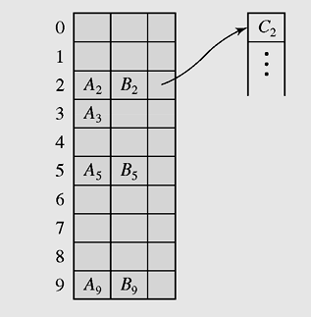
Bucket Addressing (continued)
Figure 10-9 Collision resolution with buckets and overflow area

Slide 81
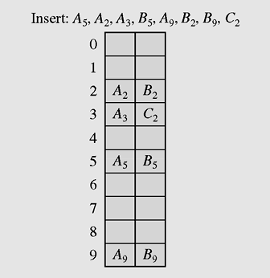
Bucket Addressing (continued)
Figure 10-8 Collision resolution with buckets and
linear probing method

Slide 82
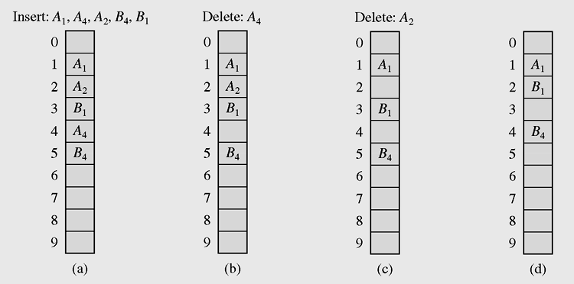
Deletion
Figure 10-10 Linear search in the situation where both insertion
and deletion of keys are permitted

Slide 83
Hashing
To find a function (h) that can transform a particular key (K) (a string, number or record) into an index in the table used for storing items of the same type as K, the function h is called a hash function
If h transforms different keys into different numbers, it is called a perfect hash function
To create a perfect hash function, the table has to contain at least the same number of positions as the number of elements being hashed

Slide 84
Perfect Hash Functions
If a function requires only as many cells in the table as the number of data so that no empty cell remains after hashing is completed, it is called a minimal perfect hash function
Cichelli’s method is an algorithm to construct a minimal perfect hash function
It is used to hash a relatively small number of reserved words

Slide 85
Cichelli’s Method
Where g is the function to be constructed
h(word) = (length(word) + g(firstletter(word)) + g(lastletter(word))) mod TSize
The algorithm has three parts:
  Computation of the letter occurrences
  Ordering the words
  Searching

Slide 86
Cichelli’s Method
Example: Build a hash function for 9 Muses:
Calliope, Clio, Erato, Euterpe, Melpomene, Polyhymnia, Terpsichore, Thalia, and Urania
  Computation of the letter occurrences at the first or the last character
E(6), A(?), ???
  Ordering the words
1) Euterpe: 6(first) + 6(last), 2)? 3)? ???
  Searching

Slide 87
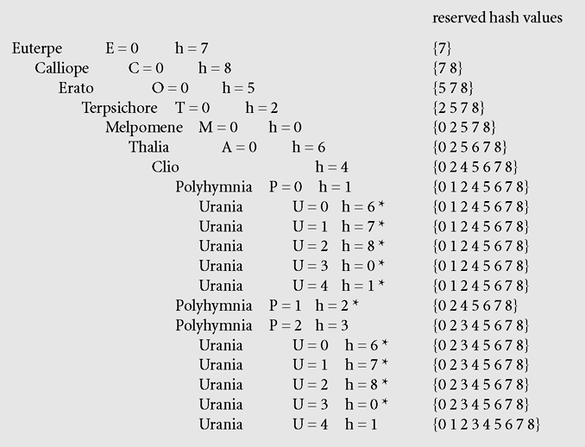
Cichelli’s Method (continued)
Figure 10-11 Subsequent invocations of the searching procedure with Max = 4
in Cichelli’s algorithm assign the indicated values to letters and to the list of
reserved hash values. The asterisks indicate failures.

Slide 89
Cichelli’s Method
Therefore: h(word) function
= (length(word) + g(firstletter(word)) + g(lastletter(word))) mod TSize
g function
g(A) = g(C) = g(E) = g(O) = g(M) = g(T) = 0
g(P) = 2
g(U) = 4

Slide 90
119544538
129554544
139564556
149574566
159584573
169594583
179604598
189614602
199624615
209634625
219644637
229654644
239664655
249674666
259684679
What is hash?
What is hash function?
What is a good hash function, [Hint: perfect hash]?
Give four examples of hash function for the given sample -> on the left.

